Slide 1

Detecting Lorentz-Symmetry Breaking in a Scalar Field
Sawyer Star
B.S. in Space Physics
Mentor: Dr. Quentin Bailey
Embry-Riddle Aeronautical University

Slide 2
What is Lorentz-Symmetry?
General Relativity (GR) and the Standard Model of particle physics (SM) are both successful models
GR does not include SM
Lorentz-symmetry is important property of special relativity
  Physics has no preferred orientation or speed

Slide 3
Why Lorentz-Symmetry Breaking
We ultimately want GR and SM to be branches of unified theory
LSB could be a consequence of that unified theory
Allows us to work with GR framework with slight modifications
Notes:
“The question then is can we even measure these LSB modifications? And how if so?”

Slide 4
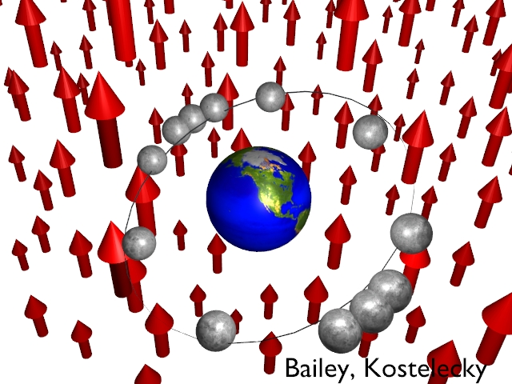

How do we see LSB occur?
Explicit
  Fixed background field in space
Spontaneous
  LSB arises through dynamics, like phase transitions
We are considering the effects of explicit LSB on a scalar field

Slide 5

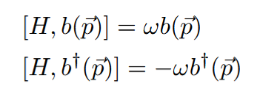
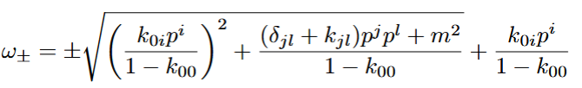
Effects
Same exact form of field energy, no extra terms.
Same form of energy in creation/annihilation operators
Actual modifications pop up in energy of particles within the field, think QHO
Notes:
plus/minus sign determines particle/antiparticle -> does extra term allow for “flipping” between the two?

Slide 6
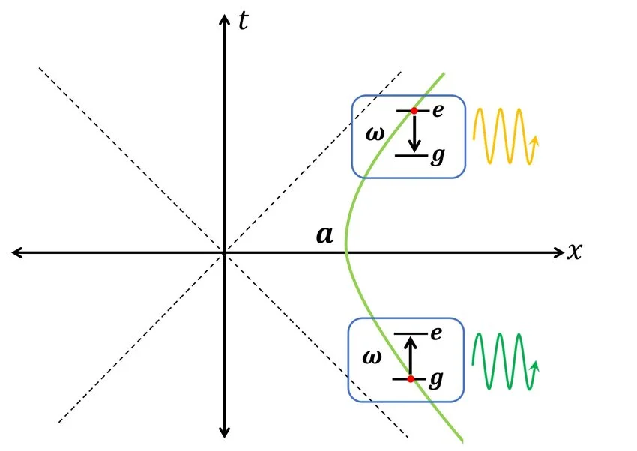
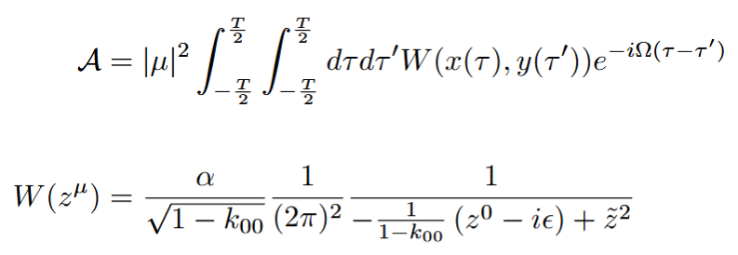
How do we detect LSB?
Unruh-Dewitt Detector makes use of Unruh effect to measure transition rates of a particle
  Unruh effect - accelerating observer will see a thermal distribution within the vacuum
Transition rate related to correlation function of two different
world lines
Azizi, Arash. 2025
‌
Notes:
Photo - Azizi, Arash. “Two-Photon Emission from Uniform Acceleration: Unruh Excitation, Radiative Decay, and Field Entanglement.” Physical Review D, vol. 112, no. 4, 20 Aug. 2025, https://doi.org/10.1103/bck9-x7gt. Accessed 1 Apr. 2026.
‌

Slide 7
Conclusions
Despite extra energy term, not possible to “flip”
  Current understanding of particles/antiparticles is sound
Expect transition probability to be related to spacetime distance with some modification scalings
  Will require precise and accurate detectors

